Slide 1
MR KOFI OKRAH AGYEI

Slide 2
CAPSTONE PROJECT

Slide 3
MR KOFI OKRAH AGYEI
CAPSTONE PROJECT
Title: Penetrating Black Box Systems:
Understanding Vulnerabilities and Implementing Security Measures
Introduction:
Black box systems, also known as closed-box systems, are software or hardware systems where the inner workings are not visible or accessible to the user. These systems are commonly used in various industries, such as aviation, automotive, and cybersecurity. While black box systems provide convenience and functionality, they also pose a significant security risk as they hide potential vulnerabilities from users. This capstone project aims to explore the challenges of penetrating black box systems, understanding their vulnerabilities, and implementing security measures to protect them from potential threats.
Objectives:
1. Investigate the common types of black box systems found in different industries and their security implications.
2. Explore the methods and tools used to penetrate black box systems and identify vulnerabilities.
3. Analyze real-world case studies of black box system breaches and their impact on organizations.
4. Develop a comprehensive strategy for securing black box systems against potential cyber threats.
Methodology:
This capstone project will involve a thorough literature review to understand the concept of black box systems, their vulnerabilities, and existing penetration.
1. Reconnaissance: This stage involves gathering information about the target system or network. This can include identifying IP addresses, domain names, network architecture, system configurations, and potential entry points for attack.
2. Scanning: In this stage, the hacker uses automated tools to scan the target system for vulnerabilities. This can include identifying open ports, services running on those ports, and potential weaknesses that can be exploited.
3. Gaining Access: Once vulnerabilities are identified, the hacker attempts to exploit them to gain unauthorized access to the target system. This can involve using techniques like brute force attacks, phishing emails, or social engineering to trick users into providing access.
4. Maintaining Access: After gaining initial access, the hacker may create backdoors or establish persistent access to the target system. This ensures that they can re-enter the system even if their initial access is discovered and blocked.
5. Covering Tracks: To avoid detection and attribution, hackers often attempt to cover their tracks by deleting log files, altering timestamps, and obfuscating their activities on the target system.
6. Post-Exploitation: Once inside the system, the hacker may escalate privileges, move laterally within the network, and exfiltrate sensitive data. This stage involves exfiltrating valuable information while avoiding detection.
7. Reporting: In ethical hacking scenarios, the hacker will document the vulnerabilities identified, the methods used to exploit them, and recommendations for improving security. This report is then shared with the organization to help them improve their defenses.
It's important to note that hacking is illegal without proper authorization, and hackers may face severe legal consequences for unauthorized access to computer systems or networks. Organizations should engage in regular penetration testing to identify and address vulnerabilities before malicious hackers can exploit them. Ethical hackers, also known as white hat hackers, use their skills to help organizations improve their cybersecurity defenses.
testing techniques. Additionally, hands-on experiments will be conducted to test the security of black box systems using tools such as penetration testing frameworks, network scanners, and vulnerability assessment tools. Real-world case studies of black box system breaches will also be analyzed to learn from past incidents and improve security practices.
Expected Outcomes:
1. A better understanding of the challenges associated with penetrating black box systems and identifying vulnerabilities.
2. Enhanced knowledge of security measures that can be implemented to protect black box systems from cyber threats.
3. Recommendations for organizations on how to improve the security of their black box systems and mitigate potential risks.
4. Contribution to the existing body of knowledge on black box system security and penetration testing techniques.
Conclusion:
Penetrating black box systems presents a unique set of challenges due to their closed nature and hidden vulnerabilities. By understanding the risks associated with these systems and implementing appropriate security measures, organizations can better protect their assets and prevent potential cyber-attacks. This capstone project aims to shed light on the importance of securing black box systems and provide valuable insights for improving overall cybersecurity posture.

Slide 4
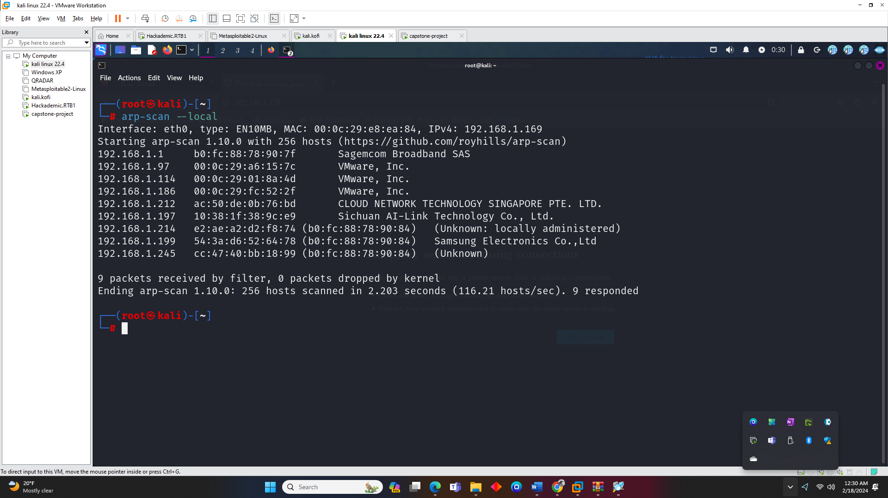

Slide 5
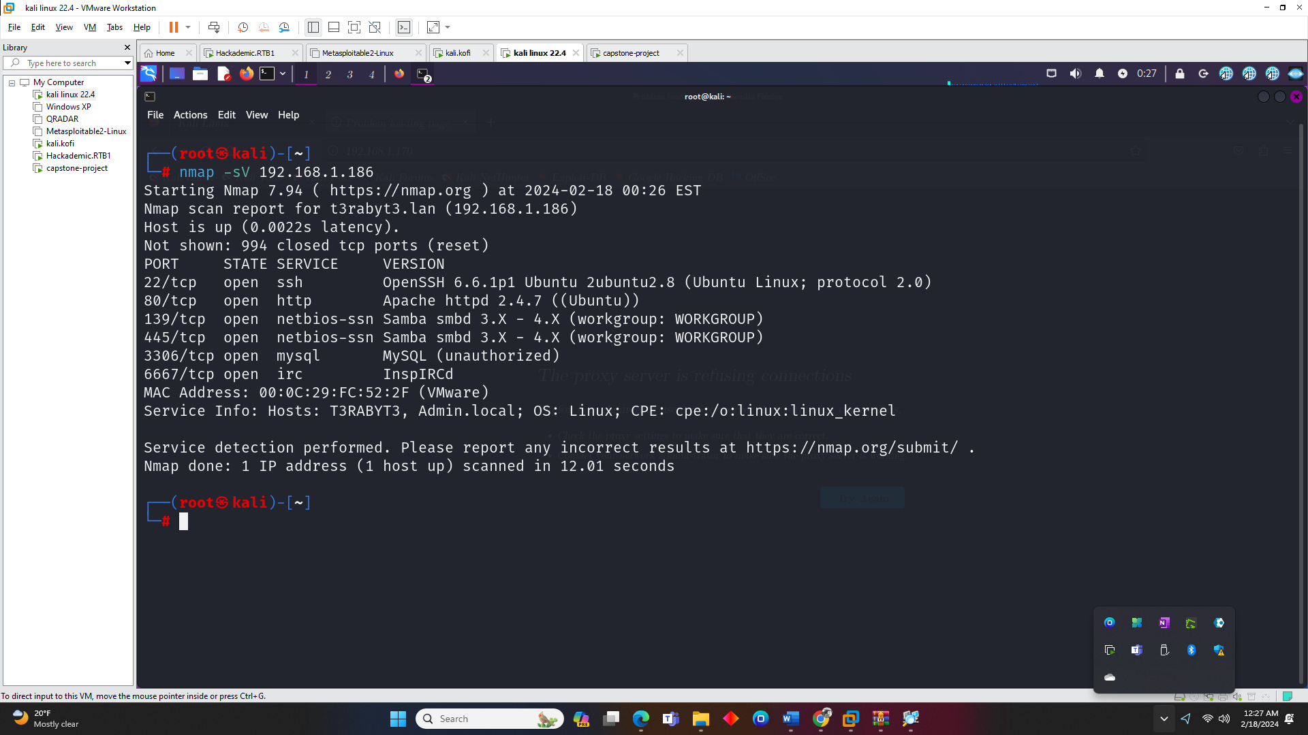

Slide 6


Slide 7


Slide 8
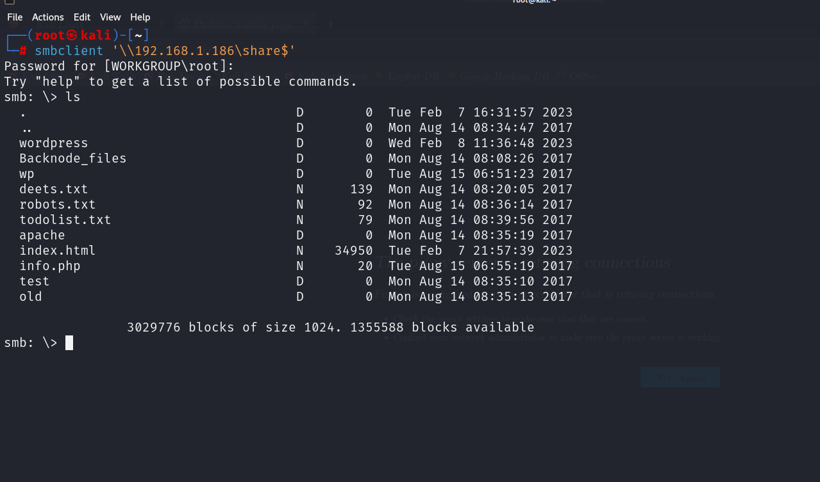

Slide 10


Slide 11


Slide 12


Slide 13


Slide 14
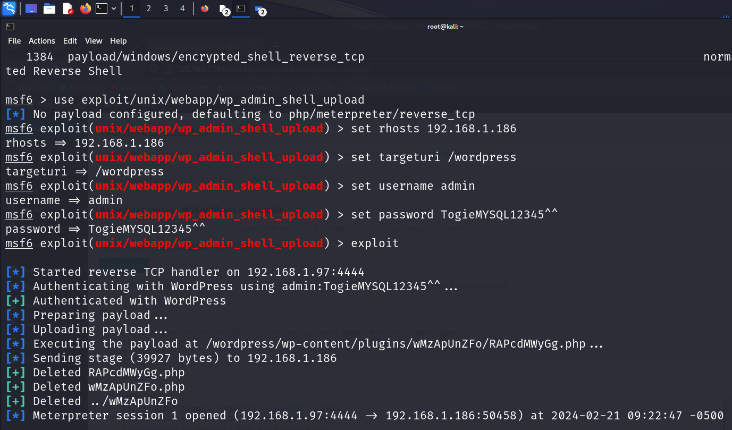

Slide 15


Slide 16


Slide 17


Slide 18


Slide 19
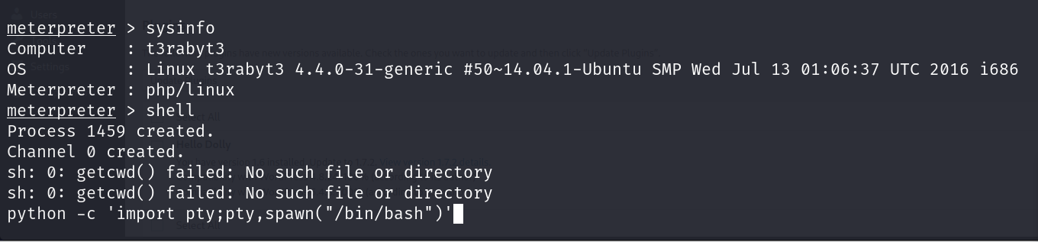

Slide 20
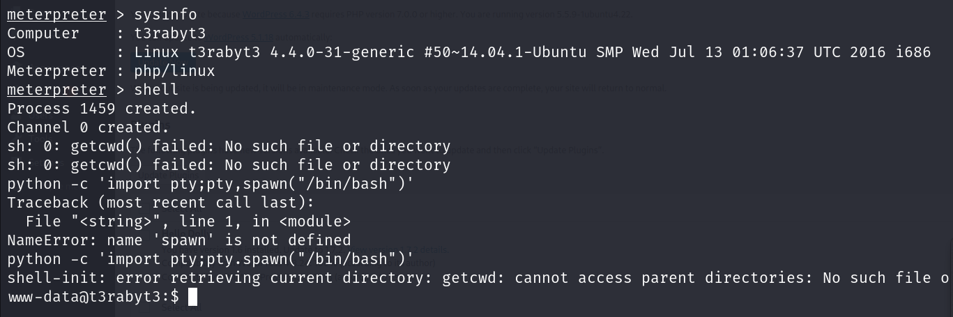

Slide 23
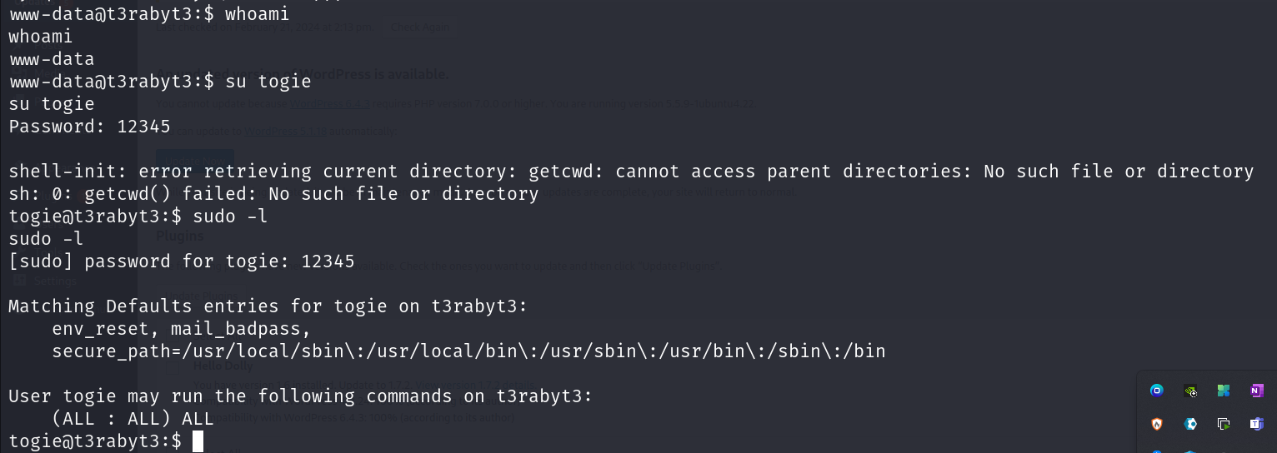

Slide 25


Slide 26
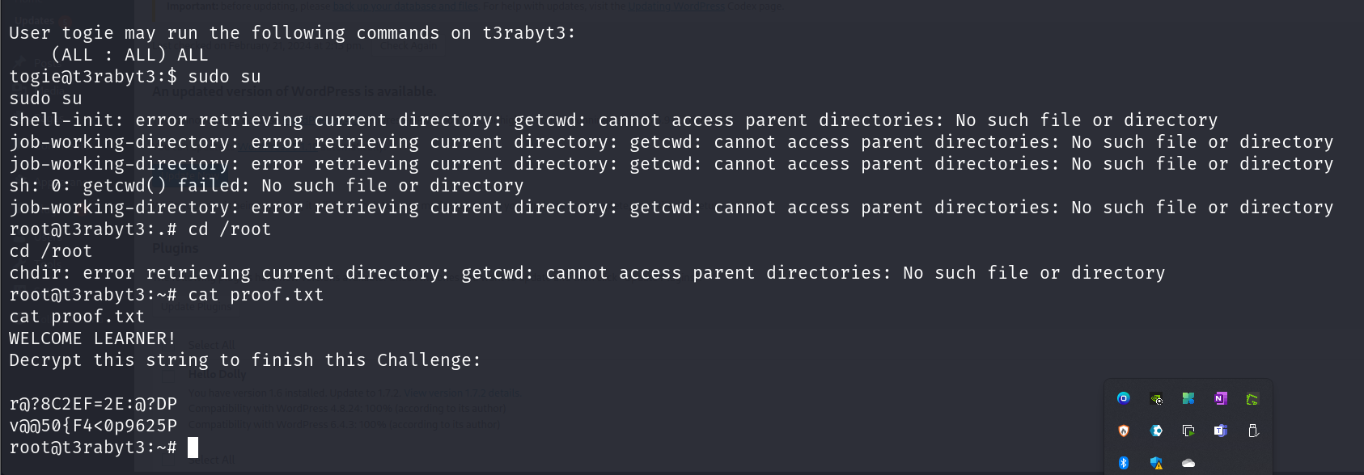

Slide 27


Slide 28


